Slide 1
Spatial-Temporal Online Learning with Sliding Window in Gaussian Processes for Tactile Object Classification
Tasbolat Taunyazov
A0192157B, e0348851@u.nus.edu

Slide 2
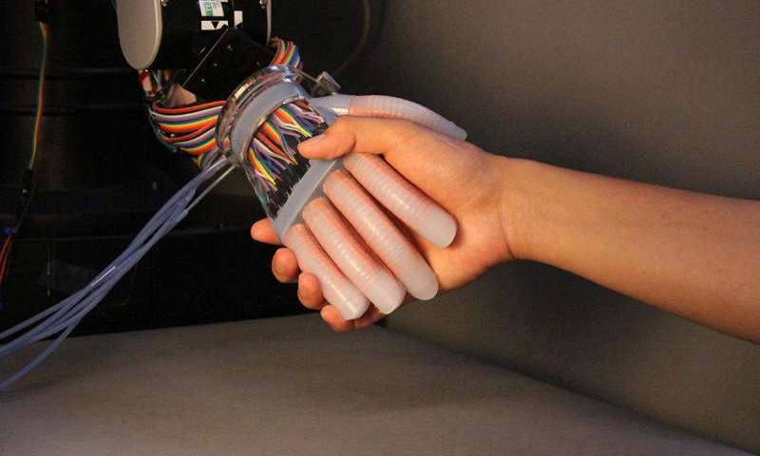
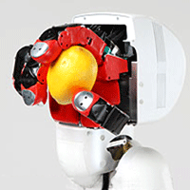
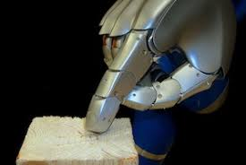
Motivation
Human Robot Interaction
Object Recognition
Texture Recognition
In many robotic tasks such as Human Robot Interaction, Objection and Texture Recognition, tactile sensors play important role to interact with world.
In this project, we focus on object recognition by tactile data
Tactile data are correlated temporally and spatially, thus our framework shall be able to handle this structures.

Slide 3
SWT-GP
Tactile sensor measures pressure when robot touches an object.
Unlike vision, tactile data don’t suffer from occlusion and continues in nature (one can imagine it as video).
We propose framework called Sliding Window Temporal Learning with Gaussian process (SWT-GP) to learn data for object classification task.
SWT-GP is generic algorithm with different possible kernels.

Slide 4
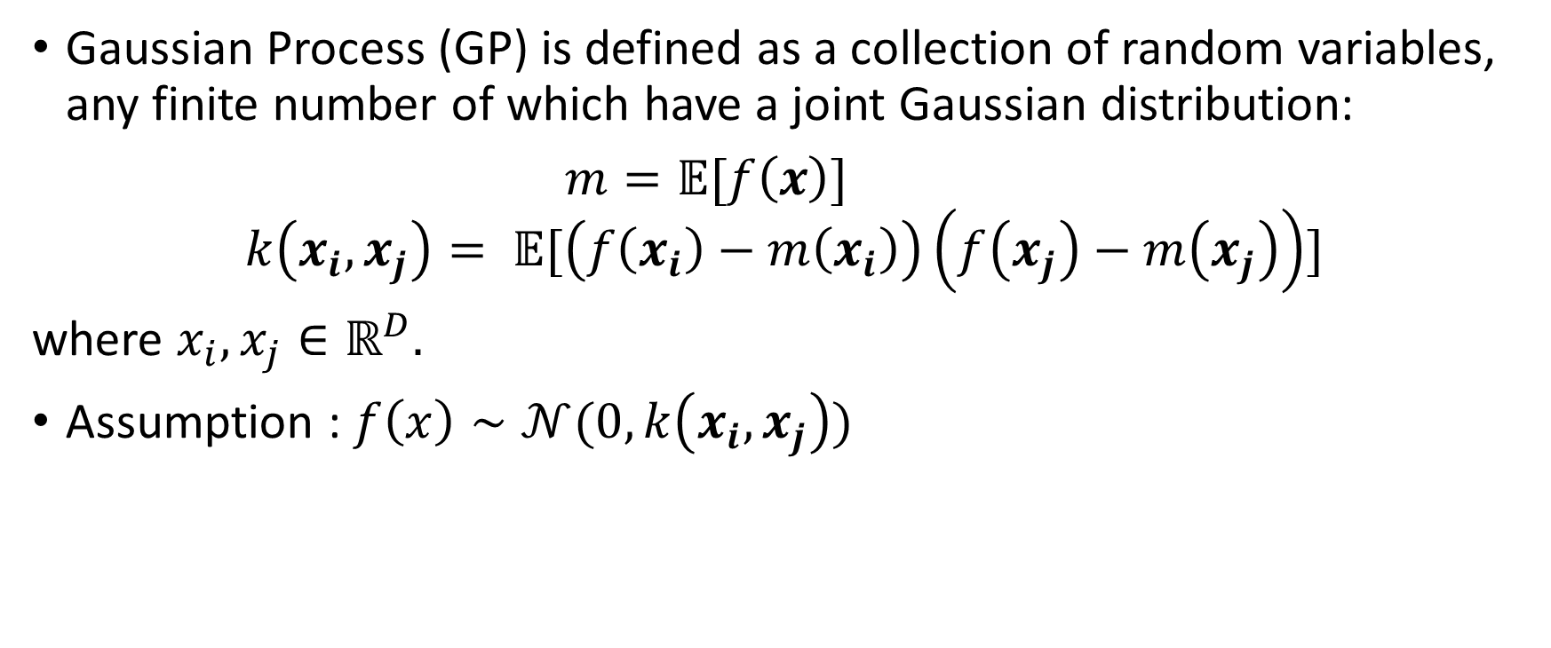
Gaussian Process
Gaussian Process (GP) is defined as a collection of random variables, any finite number of which have a joint Gaussian distribution:
$m=𝔼[f\left(x\right)]$
$$k\left(x_{i}, x_{j}\right)= 𝔼[\left(f\left(x_{i}\right)−m\left(x_{i}\right)\right)\left(f\left(x_{j}\right)−m\left(x_{j}\right)\right)]$$
where $x_{i}, x_{j}∈ℝ^{D}.$
Assumption : $f\left(x\right)∼𝒩(0,k\left(x_{i},x_{j}\right))$

Slide 5
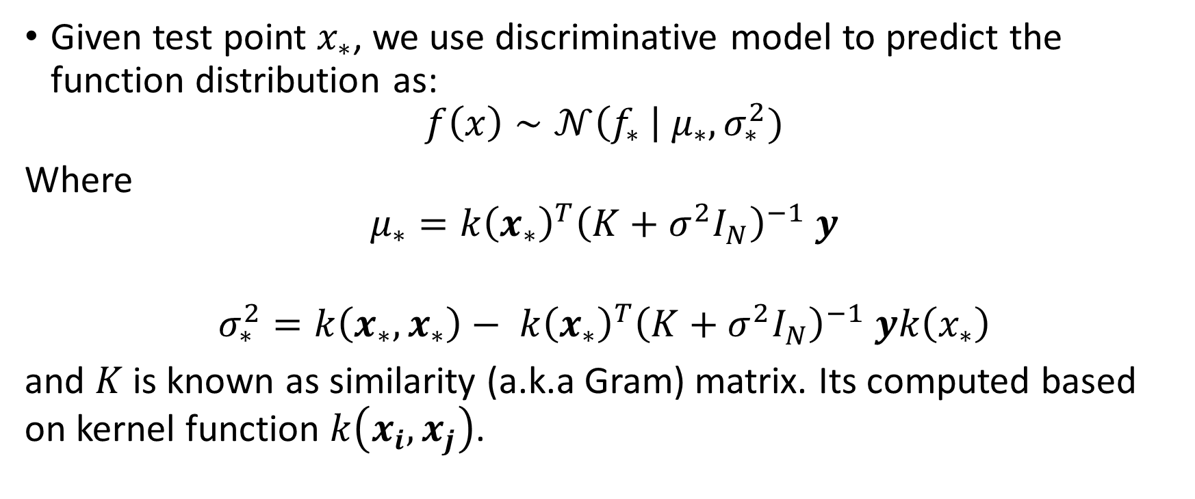
Gaussian Process (Discriminative Model)
Given test point $x_{∗}$, we use discriminative model to predict the function distribution as:
$$f\left(x\right)∼𝒩\left(f_{∗} \right| μ_{∗}, σ_{∗}^{2})$$
Where
$$μ_{∗}=k{\left(x_{∗}\right)}^{T}{\left(K+σ^{2}I_{N}\right)}^{−1} y$$
$$σ_{∗}^{2}=k\left(x_{∗}, x_{∗}\right)− k{\left(x_{∗}\right)}^{T}{\left(K+σ^{2}I_{N}\right)}^{−1} yk\left(x_{∗}\right)$$
and $K$ is known as similarity (a.k.a Gram) matrix. Its computed based on kernel function $k\left(x_{i}, x_{j}\right)$.

Slide 6
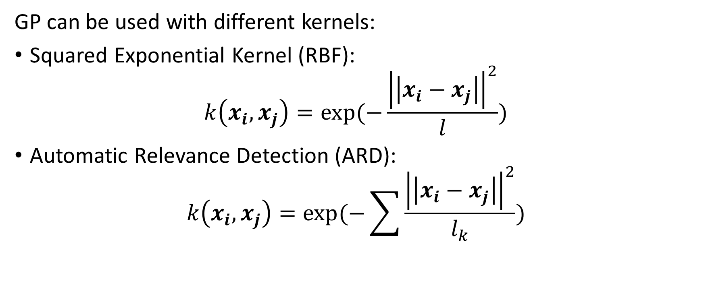
Kernels
GP can be used with different kernels:
Squared Exponential Kernel (RBF):
$$k\left(x_{i}, x_{j}\right)=exp⁡(−\frac{{\left|\left|x_{i}−x_{j}\right|\right|}^{2}}{l})$$
Automatic Relevance Detection (ARD):
$$k\left(x_{i},x_{j}\right)=\exp{(−\sum{\frac{{\left|\left|x_{i}−x_{j}\right|\right|}^{2}}{l_{k}}})}$$

Slide 7

Recursive Kernel
While ARD kernel handles spatial correlation in data, recursive kernel can pass history data to the current state (similar to RNN):
$$k^{t}\left(x_{i},x_{j}\right)=\exp{(−\sum{\frac{{\left|\left|x_{i}−x_{j}\right|\right|}^{2}}{l_{k}}})}exp⁡(\frac{k^{t−1}\left(x_{i},x_{j}\right)−1}{ρ^{2}})$$

Slide 8
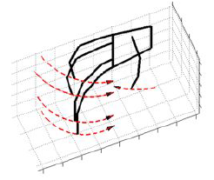
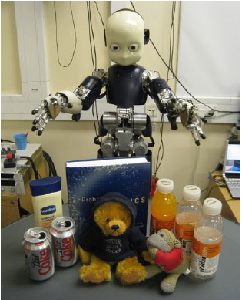
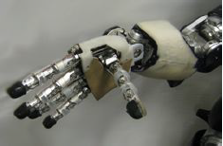
Tactile Dataset
Humanoid iCub robot grasps 9 different objects 20 times. Each time hand starts with pre-grasping pose and grasps with specified trajectory.
The dataset is in open source and can be downloaded by following link: https://bitbucket.org/haroldsoh/otl/downloads/
Motion during grasping
9 Different object: full and empty soda cans, full, half full and empty bottles, Teddy-bear, monkey toy, book and lotion.
Pre-grasping pose

Slide 9
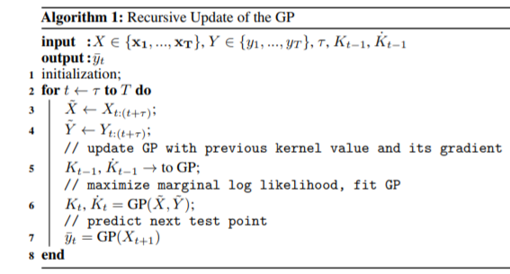
Implementation
Online learning with SWT-GP is implemented using following algorithm to classify object and improve the accuracy incrementally:

Slide 10
Implementation
SWT-GP is tested in different scenarios with different kernels:
Scenario 1: GP with Standard RBF kernel
Scenario 2: GP with ARD kernel
Scenario 3: GP with Recursive RBF kernel
Scenario 4: GP with Recursive ARD kernel
Isotropic kernels
Anisotropic kernels

Slide 11
Results: Accuracy score
Isotropic kernels
Anisotropic kernels

Slide 12
Results: Execution time
Isotropic kernels
Anisotropic kernels

Slide 13
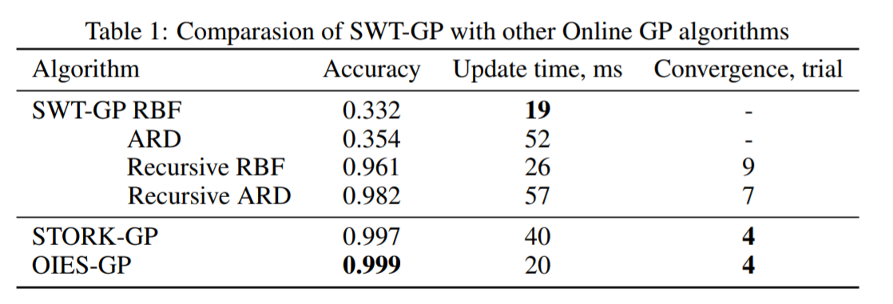
Results: Benchmarking

Slide 14
Conclusion
SWT-GP algorithm is proposed for online learning to classify objects from tactile data.
The algorithm is tested in 4 different scenarios with different kernels.
Tactile object classification is feasible using GPs.
In the future, window size must be analyzed in detail.

